Slide 1
Retailing
Objectives

Slide 2
Move
Transform
our exclusive
products
your customers’
shopping
experience
Move
our partner
stores
Create
memorable
experience

Slide 3
know your products very well
make smart product suggestions
sell the benefits
be a product-of-the-product yourself
be a specialist

Slide 4
personalise your relationships
(every customer is unique... every customer special)
Listen… be sensitive to their needs
put their interest first
be honest... be trustworthy
be a friend

Slide 5
use selective
retailing concepts
match
to different target customers
be sharp

Slide 6
Retailing
Concepts

Slide 7
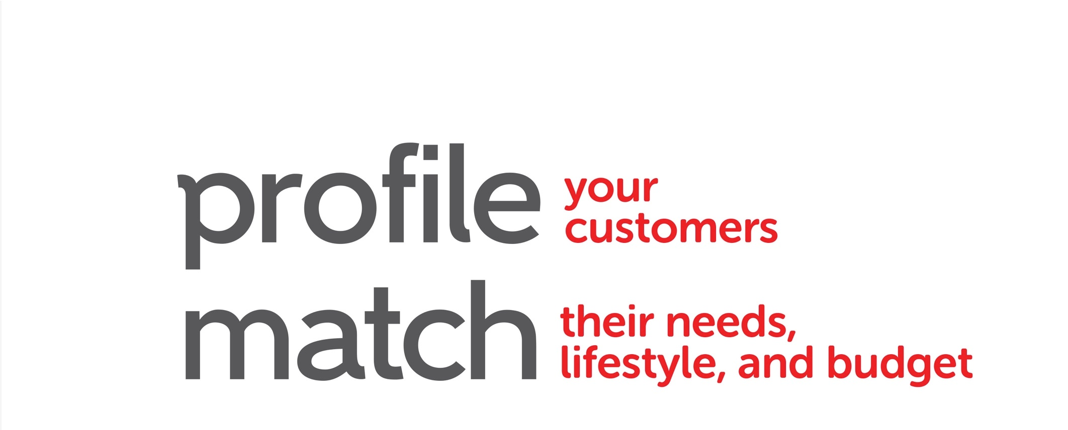

Slide 8
• Show them the option
of shopping from the
comfort of their home
Show
the benefits,
the time savings,
the convenience,
the comfort
• Pre-select some items
for them
• Give them sufficient
information to make
quick purchase decisions

Slide 9
• Invite them for home events
Love to
touch and
feel products
–
want choices
+ variety
• Sampling
• Share creative ways you
can use our products
eg: using Isotonix to make jelly, cocktails,
using Skintelligence Ph. normalizer for
hair volume

Slide 10
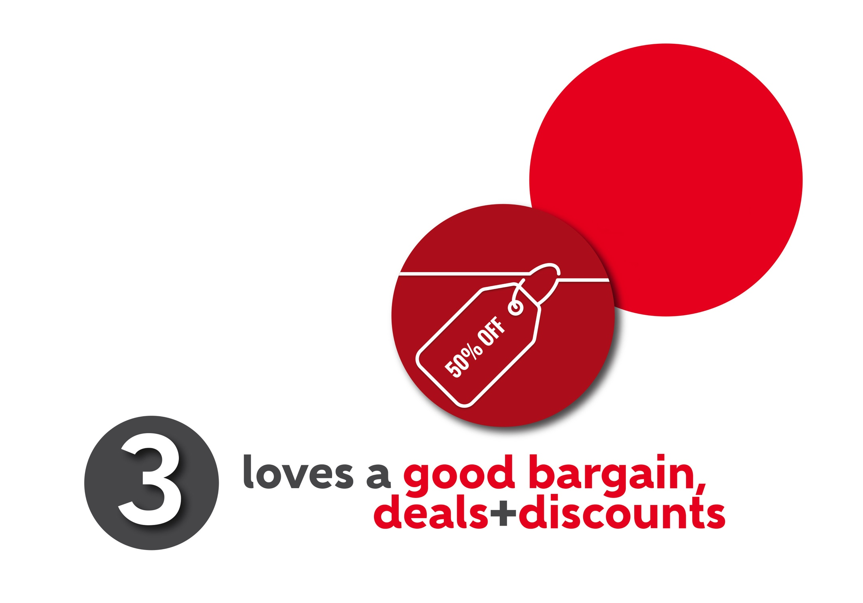
bulk
purchases
bundle buys
for better
deals
• Inform them of special
deals/buys
• Customised package
• Give freebies

Slide 11
• Wants exclusivity
Brand
your products
as exclusive,
unique and special
• Invite/gather like-minded
people together
• Organise theme
parties

Slide 12
Thank you.

